Slide 1
SHIFT Kentucky Ahead
Strategic Highway Investment Formula for Tomorrow

Slide 2
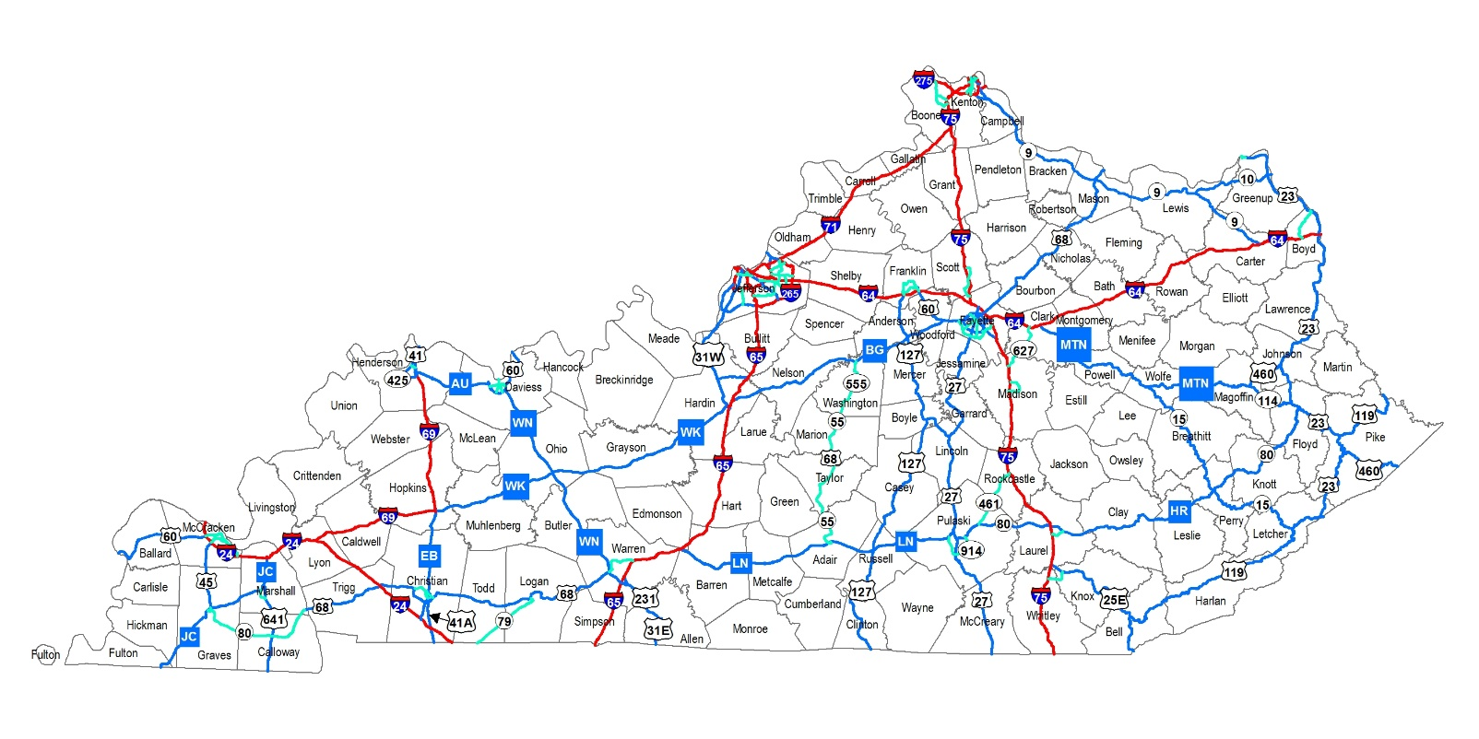
More Projects Than Dollars
For many years, Kentucky’s highway plan has overpromised
More than 1,400 projects in the Highway Plan
Only half are even partially funded, mostly with federal dollars
Result: Undermines public confidence because you can’t count on projects in the plan
Notes:
Kentucky’s Highway Plan has overpromised for many years
Only half of the 1,400 projects are even partially funded
The public doesn’t have confidence in the plan

Slide 3
State Projects Vastly Exceed Funding
More than 90 percent of the state-funded projects in the current Highway Plan don’t have state dollars to pay for them
In other words, Kentucky has 10 TIMES as many state-funded highway projects budgeted as dollars available
Overpromising creates expectations that cannot be fulfilled for many years – if at all
Notes:
Kentucky is overpromising state dollars for projects.
We only have money to pay for 10 percent of the $7.1 Billion of projects promised with state funds in the Highway Plan.
As you can see, the comparison is stark. The promises are far greater than the $690 Million in state dollars we anticipate to be available in this time frame
This includes the $50 Million in the current biennium

Slide 4
Time to SHIFT Kentucky Ahead
Embrace data-driven approach to guide transportation spending
Establish clear priorities
Invite input at district, local level
Provide transparency
Deliver reliable, dependable plan for businesses, citizens
Create confidence for future federal, state infrastructure investment
Notes:
In conclusion, SHIFT will help move Kentucky ahead with a data-driven vehicle for transportation spending priorities
It will increase input at the district, local levels
It will provide much more transparency than our current approach
It will help us deliver a plan than citizens and business can rely upon
And that will help instill confidence in the work that we do and build support for future infrastructure investment
It’s time to SHIFT Kentucky Ahead

Slide 5
Top Priorities
Improve Safety
Preserve Existing Infrastructure (Asset Management)
Fuel Economic Growth
Spend Tax Dollars Wisely (Benefit/Cost)
Reduce Congestion
Notes:
SHIFT puts the priority on five key areas
(Read list)

Slide 6
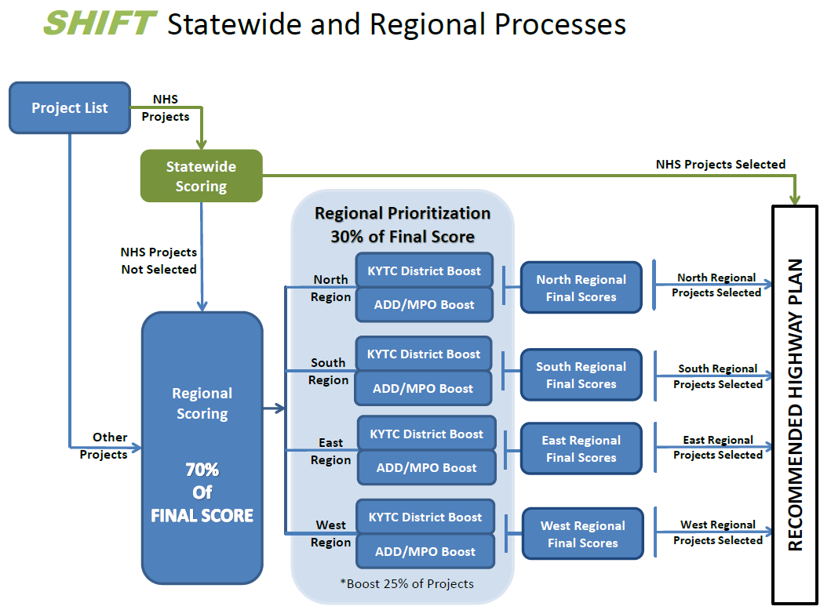

Slide 7
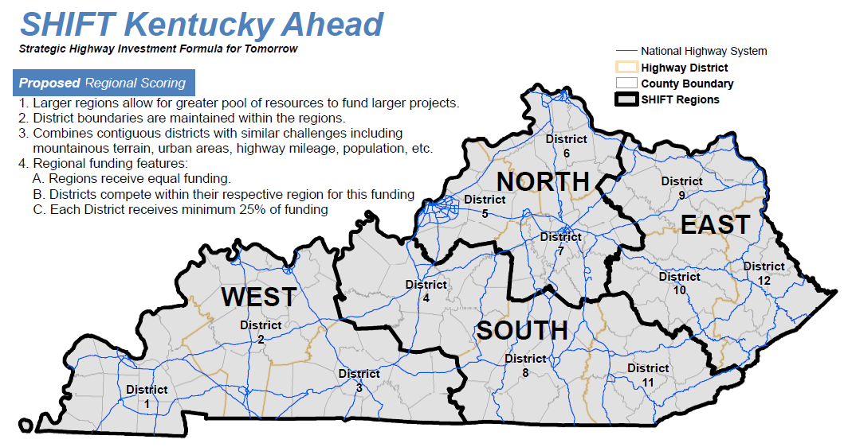

Slide 8
Developing Highway Plan
KYTC Develops Initial Project List
District, Local Leaders Identify Needed Changes
KYTC Calculates Scores for Statewide, Regional Projects
District, Local Leaders Provide Input on Regional Projects
KYTC Develops Draft Highway Plan for Governor
Governor Finalizes, Presents Plan to General Assembly
General Assembly, Governor Enact Highway Plan
Notes:
SHIFT provides a collaborative process that involves district and local officials throughout the process
It begins with KYTC developing an initial list based on the current SYP, a baseline if you will
District and local leaders have the opportunity to suggest changes – additions, deletions – and involve citizens in the discussion
With the revised lists, KYTC will use the formulas to score the projects
KYTC will share those results with district and local leaders
They will then have a chance to weigh in on which regional projects should move up in the priority rankings
With this data and revenue estimates, KYTC will develop a draft SYP to present to the Governor
The Governor will finalize the plan and present it to the General Assembly for action

